Slide 1
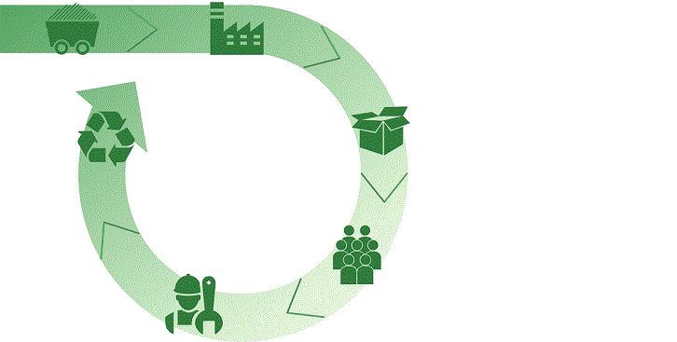
Waste Sorting System Scalable . Improvable . Faster
TEAM : UNIVERSITI MALAYA
MEMBERS : TAN KAH CHUN
CHAN JUN HOONG

Slide 2
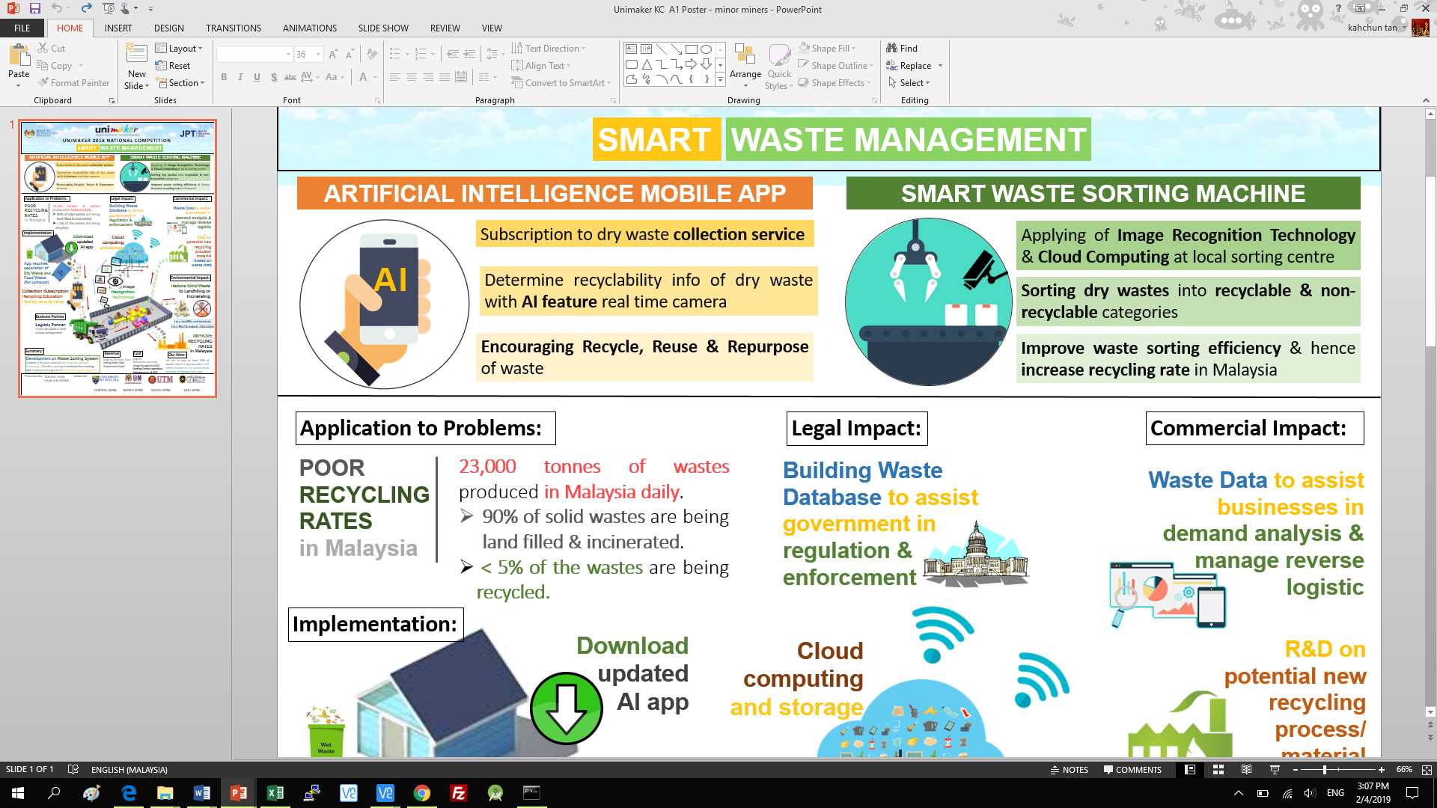
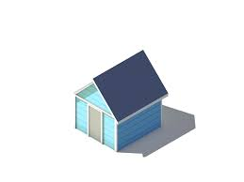


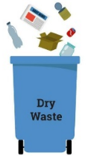

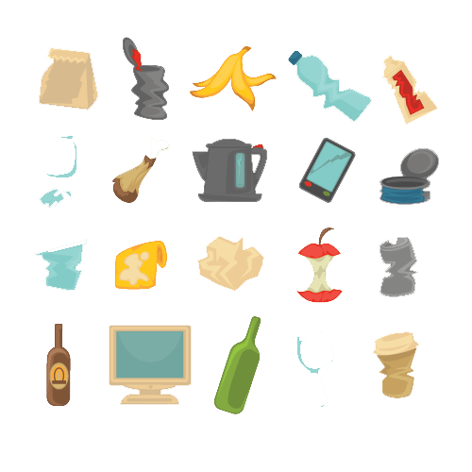
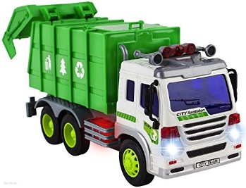



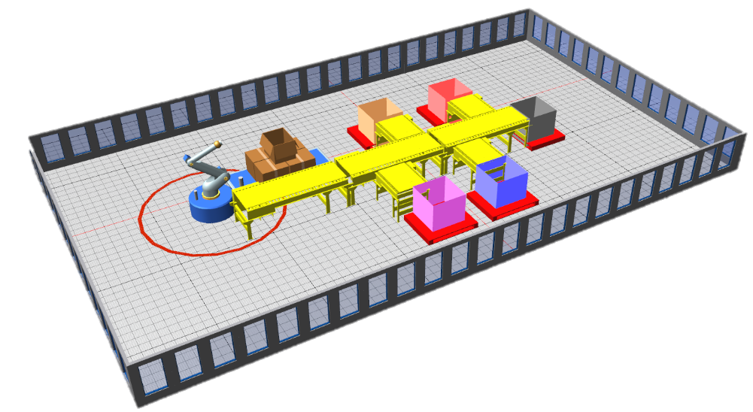



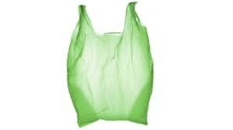
Product Background
AI MOBILE APP
AI WASTE SORTING CENTRE
Implementation
1) User download App(optional) to enjoy more benefits & information when recycling
2) User required to separate Dry Waste from Food Waste
3) Logistic Partner collect dry waste & send to local sorting centre , food waste to compost centre, all built near existing landfill
4) Dry waste sorted with Image Recognition Technology
5) Higher recycling rate, generate more social, economic value with waste data

Slide 3
Problem Statement
Government target recycling rate = 30% in 2020 including composting
BUT
Our recycling rate only~17.5% in 2016
YET
60-80% of waste composition discovered in our landfill are recyclables.
Meanwhile, Germany’s recycling rate is 62% in 2010
(Y. C. Moh & Abd Manaf, 2014).
Solution:
Waste Sorting Centre powered by AI

Slide 4



Impact
Commercial:
Waste Data to assist businesses in demand analysis & manage reverse logistic
R&D on potential new recycling process/ material based on actual waste data
Legal :
Building Waste Database to assist government in regulation & enforcement
Environmental :
Reduce Solid Waste to Landfilling or Incinerating

Slide 5
Business Model
Revenue
-Material Recovery Sales
-Selling Waste Data
-Government Grant
Cost
-Logistic
-Recyclables payment
-Image Recognition R&D
-Sorting Centre operation
-Maintenance of APP

Slide 6
Partners
Existing Waste Collection Company
Collect dry waste & send to local sorting centre
Institutions & Commercial Centre:
Trial of collection within local environment
Local Government :
Enforce waste collection segregation via our collection channel

